Slide 1
Proton Plan Status
March Report
Eric Prebys
Jeff Sims

Slide 2
Technical Progress Report

Slide 3
Progress
Baseline plan – The majority of scheduled tasks have been assigned dates and populated with resources based on information provided by level 3 managers.
Technical Progress
  Linac
  1.01.01 PA Vulnerability –
    AD Effort - 7835 tubes have been ordered
  1.01.02 Quad PS - ?
  1.01.03 Instrumentation - ?
  Booster
  1.02.01 Determine Rep Rate Limit -?
  1.02.02 Orbump –
    TD Effort - First Magnet is complete. 15% complete with the assembly of the remaining magnets (costs collected in Run II)
    AD Effort - Power supply specification and simulations are complete. Procurement is now underway.

Slide 4
Progress
  Booster
  1.02.03 Correctors –
    TD Effort – Design and Early Procurements are beginning.
  1.02.04 30 Hz Harmonic - ?
  1.02.05 Gamma T - ?
  1.02.06 Alignment Improvements - ?
  1.02.07 Drift Tube Cooling - ?
  1.02.08 Cavity #20 - ?
  1.02.09 SS RF PA’s – Descoped
  1.02.10 Instrumentation Upgrade - ?
  1.02.11 Booster Dump Relocation –
    NEW SCOPE – Recent meetings with AD Rad Safety and FESS to determine if we can fit this scope into the upcoming shutdown.
  1,02,12 – Booster Chopper – NEW SCOPE -?

Slide 5
Progress
  Main Injector
  1.03.01 Large Aperture Quads –
    TD Effort – Design and Procurement are nearly complete. Fabrication of the first unit is 30% complete.
  1.03.02 Collimation –
    AD Effort - Beam loss studies in MI and MI-8 are ongoing. Residual Radiation measurements and simulations will begin soon.
  1.03.03 NuMI MultiBatch Operations –
    Barrier Bucket Procurement , Mixed Mode Operations
    NEW SCOPE- Injection Kicker Replacement, Extrraction Kicker Modifications
  1.03.04 RF Upgrade –
    Prototype - ?
    Upgrade –
      Study Groups: The current plan is to use information from the prototyping and the Proton Study Group to determine what type of upgrade is necessary. A study group to evaluate the use of feed forward to maximize intensity is planned for this summer.
      Line Item Project: A decision point is planned in early 2006 for the upgrade scope. Early estimates for cavity replacement suggest this scope of work may be appropriate as a MIE Line Item project.

Slide 6
Progress
  Studies
  1.05 Proton Study Group–
    NEW SCOPE -A study group lead by Mike Syphers will evaluate the operation of the proton complex.

Slide 7
Proton Delivery
We did not plan for NuMI target problems, and the extent of their impact is still uncertain.
Will concentrate on total proton delivery:
  Hourly rates: compare actual total rate to pbar+BNB+NuMI projections.
  Integrated total: compare MiniBooNE actual to BNB+NuMI projections.
Except for shutdown dates, these have not changed for 2005 since the November document.

Slide 8
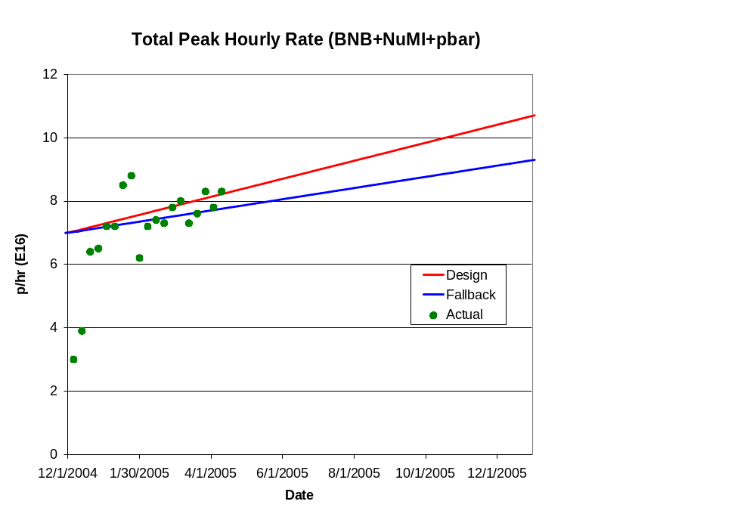
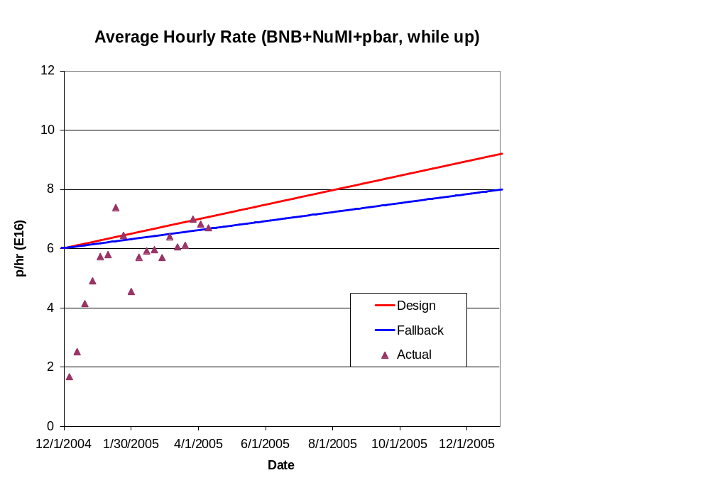
Hourly Proton Rate

Slide 9
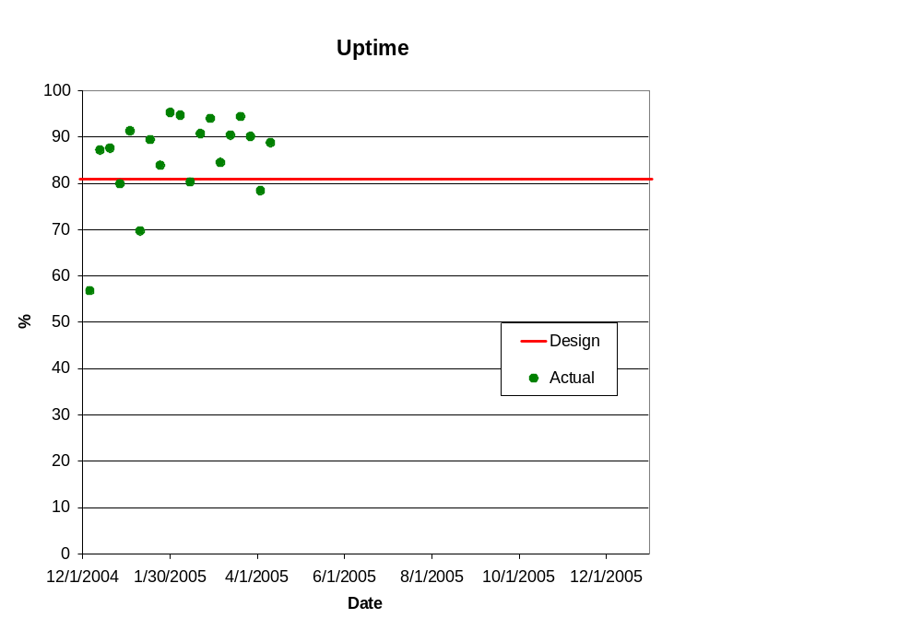
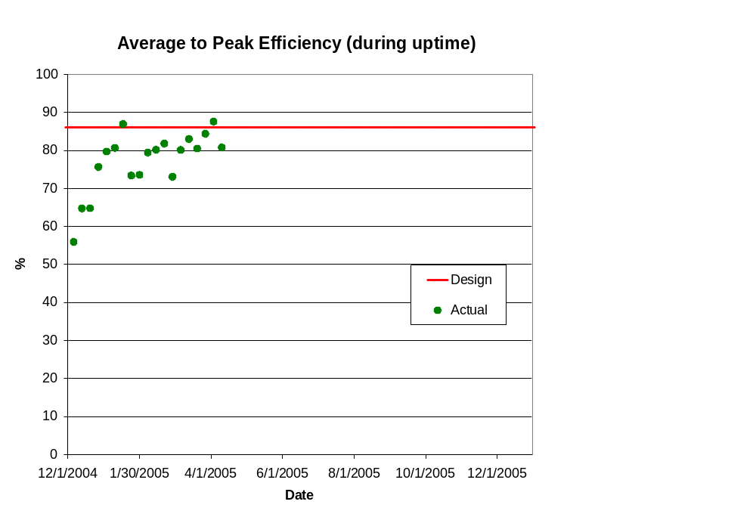
Efficiencies

Slide 10
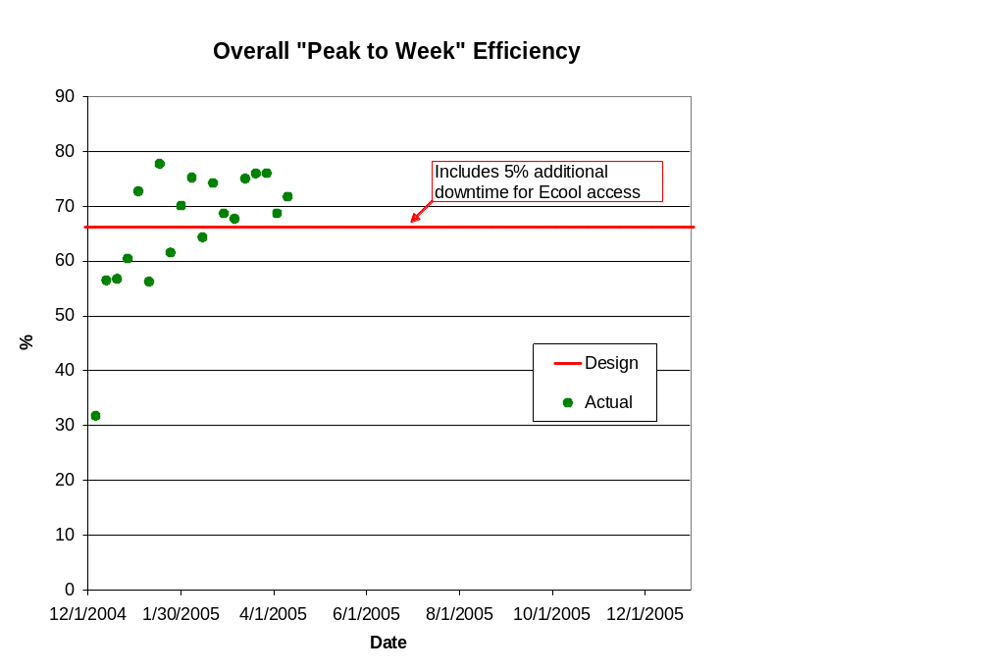
Overall “Peak to Week” Efficiency

Slide 11
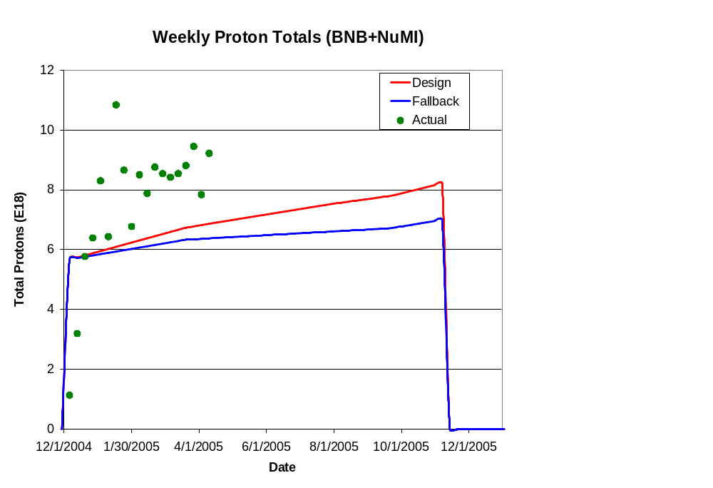
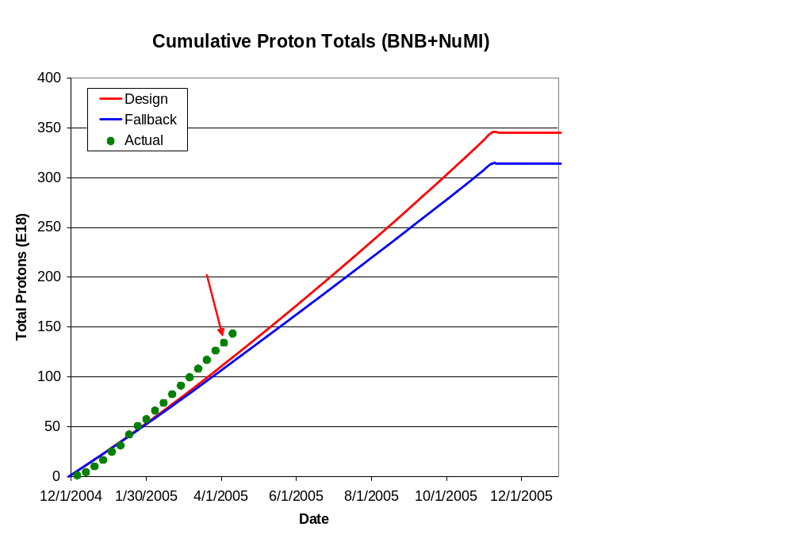
Integrated Delivery (BNB)

Slide 12
Status Report

Slide 13
Proton Plan Baseline Schedule Level 4 summary
Add Level 4 gant summary here with indicators on How the estimate was done (Top Down, Bottoms up) and whether or not it is a good candidate for AIP/MIE. Highlight new scope

Slide 14
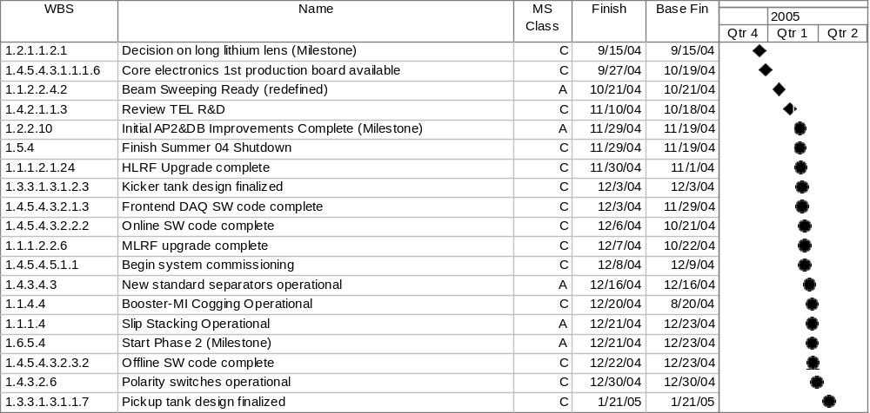
All Milestones

Slide 15
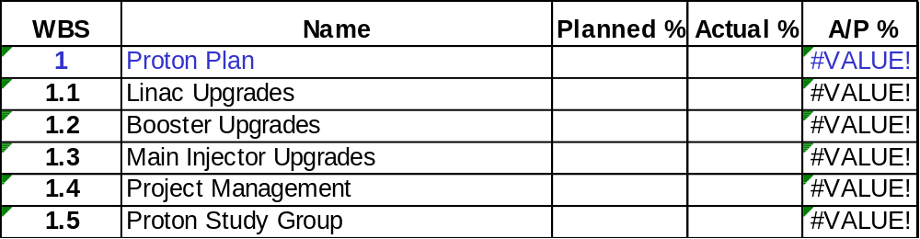
Progress as of March 31, ‘05

Slide 16
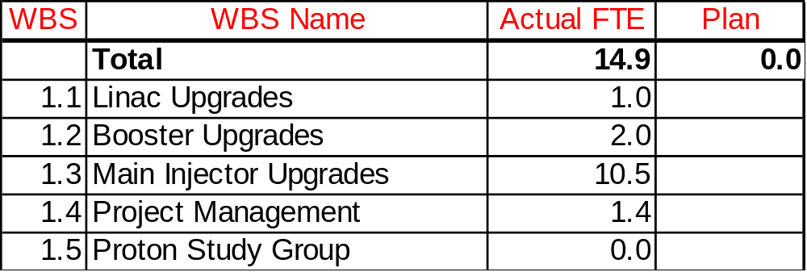
Effort for March ‘05

Slide 17
Proton Plan SWF Planned Usage
Add graphs on FTE usage here

Slide 18
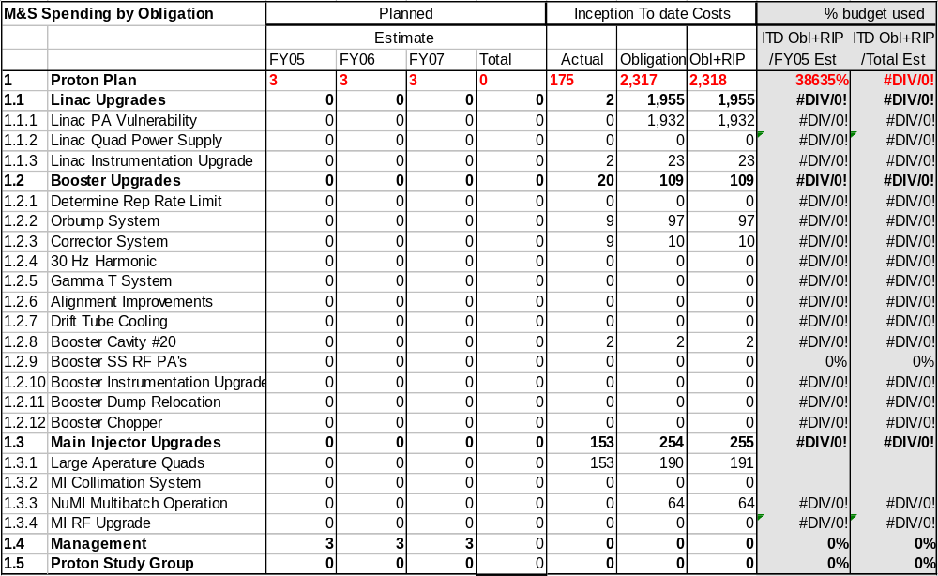
M&S Spending– Direct, No Contingency

Slide 19
M&S Spending Profile
Add table on Spending Profile of M&S from Plan verses Budget Guidance here

Slide 20
Summary
Upcoming Project Management effort for the Proton Plan :
  All changes to the plan from here on out will be through Change Control procedures.
  Continue to improve estimates of top down sections.
  In the near future earned value and obligation reporting will be done via COBRA.
  A contingency analysis will be performed to more accurately reflect the current estimate of each section. The baseline plan reflects a 40% across the board contingency.
  All monthly effort reporting from divisions will be provided to the Level 3 managers to ensure we have the right people.
  Attempt to identify any potential AIP/MIE projects within the Proton Plan.
  Prioritize the scope of the baseline Proton Plan to understand if we need to remove any scope to stay within the budget guidance.

